Slide 1



National Taiwan University
System Optimization Laboratory
Predictive Velocity Obstacle Method for Mobile Robot Motion Planning Among Dynamic Obstacles with Unknown Intentions

Slide 2
Introduction
Methods
Results
Discussion

Slide 3
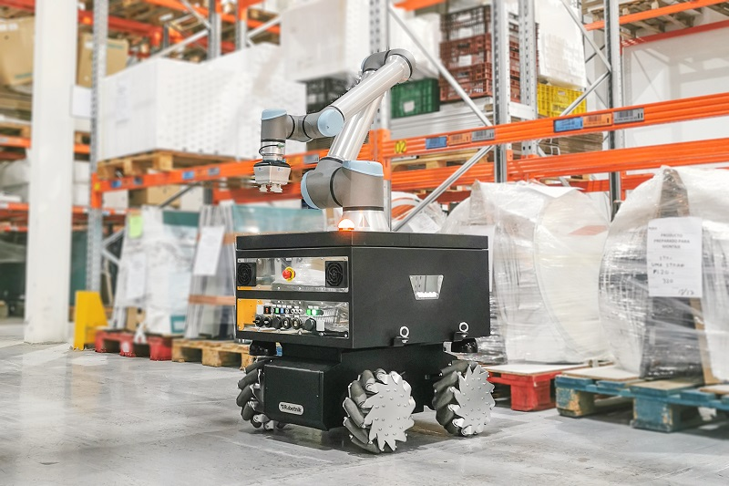

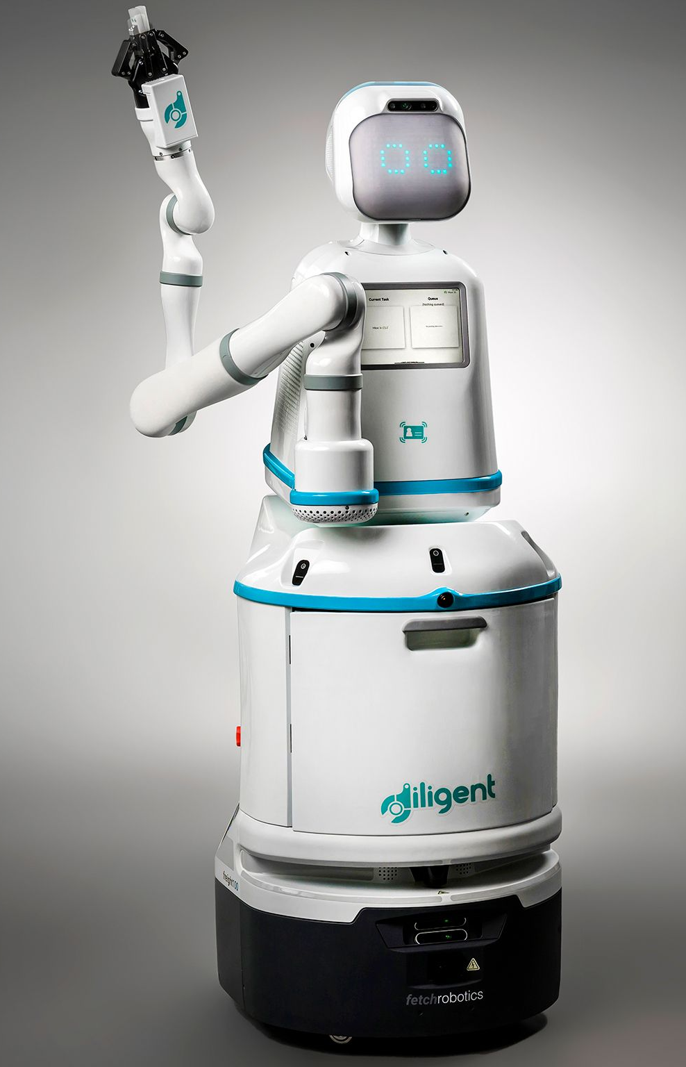


Autonomous Mobile Robots (AMR)
Motion Planning
Introduction
Methods
Results
Discussion

Slide 4
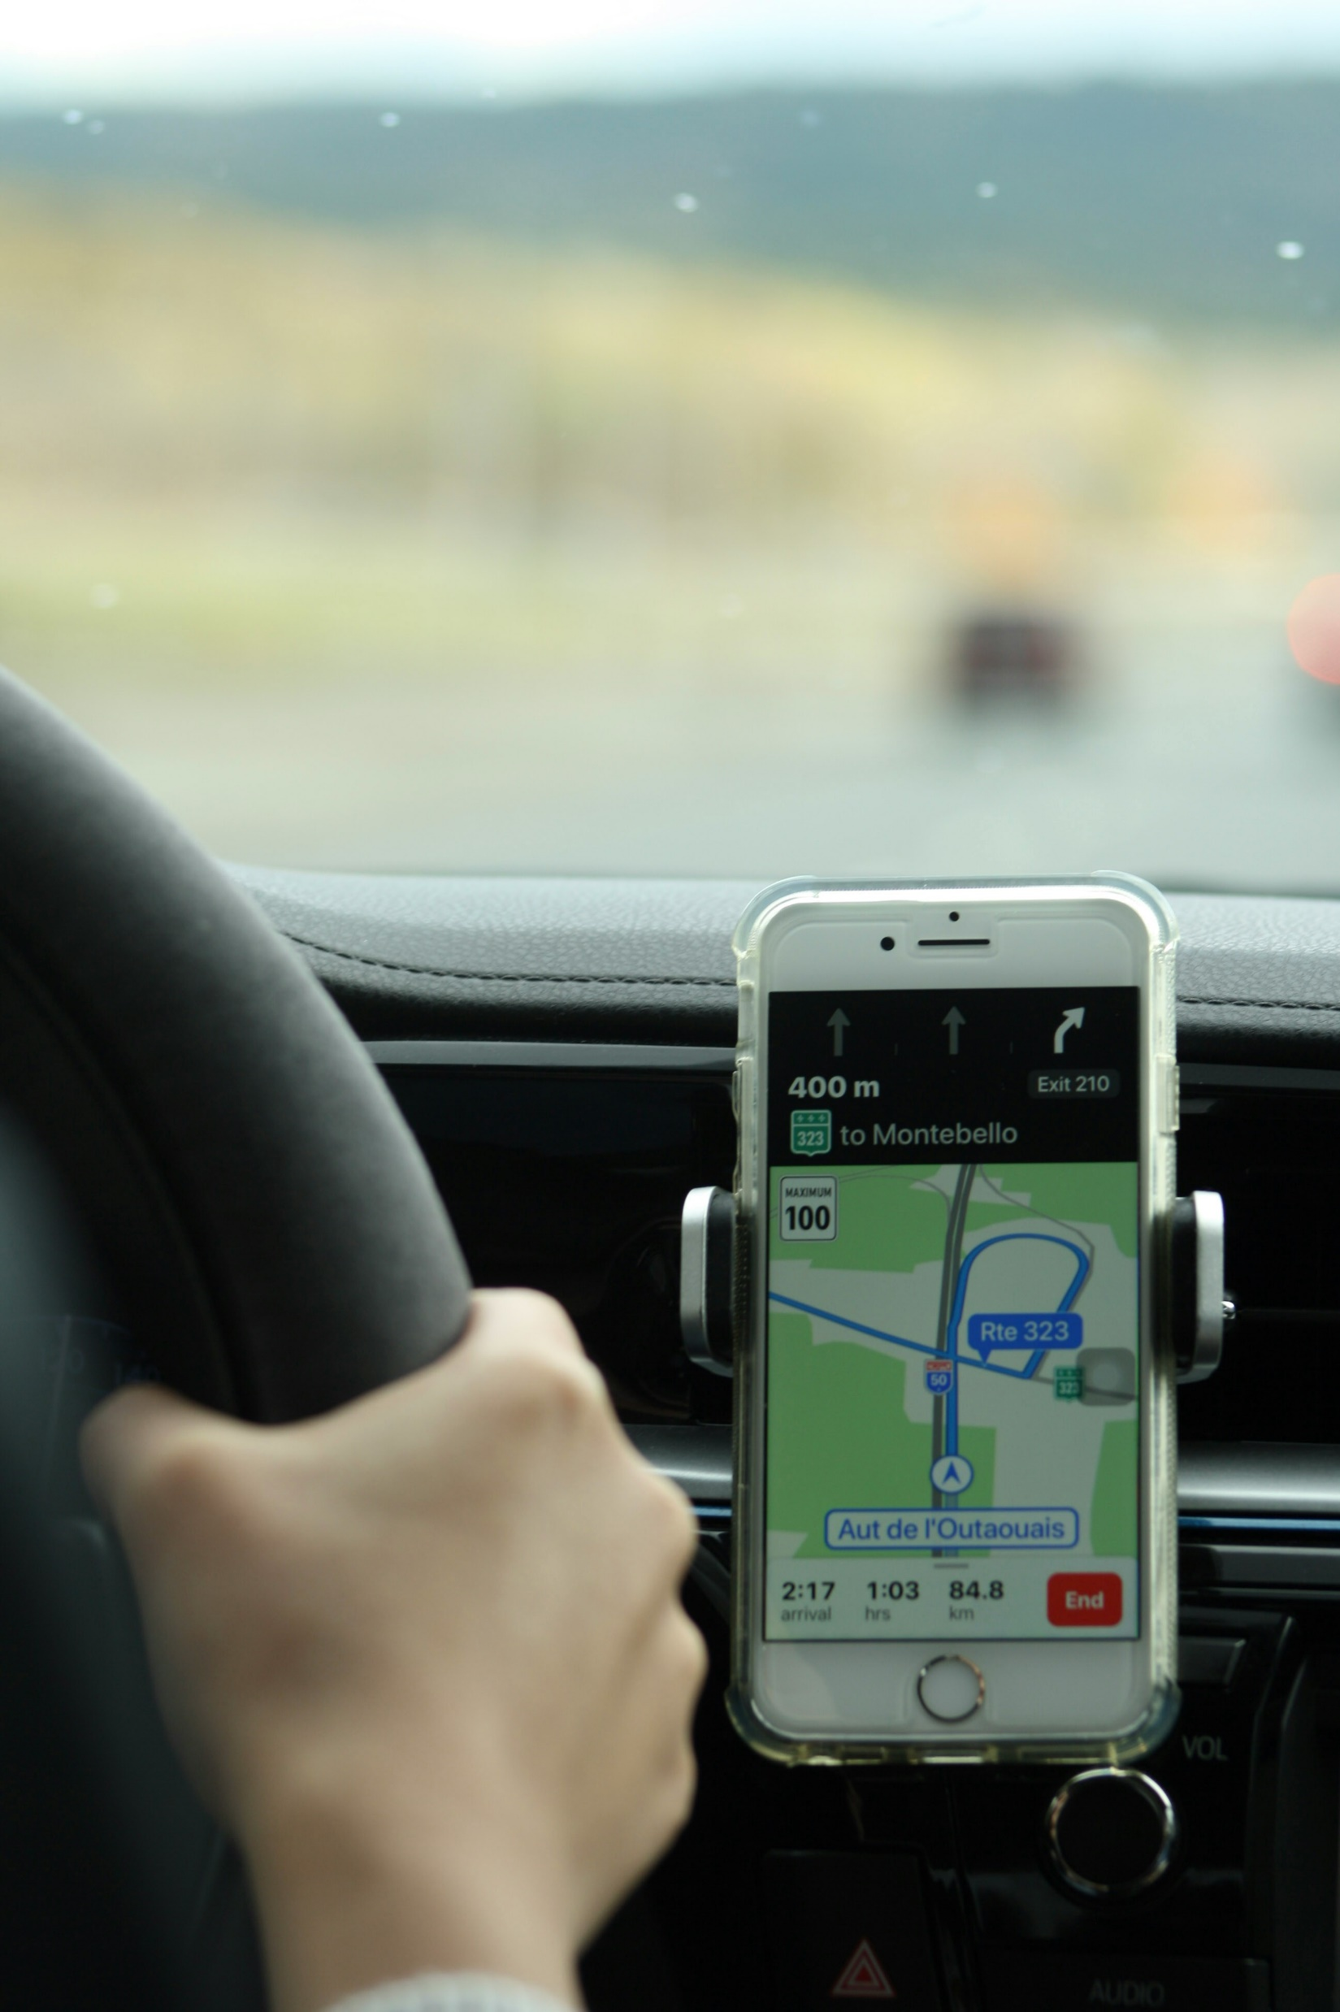
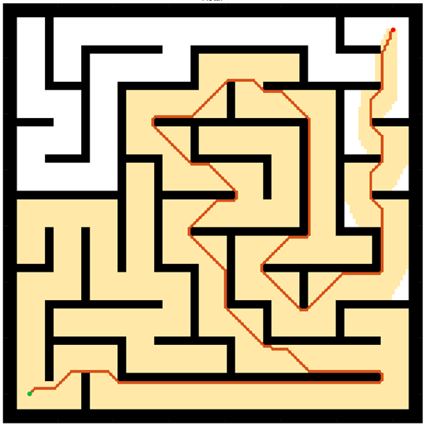
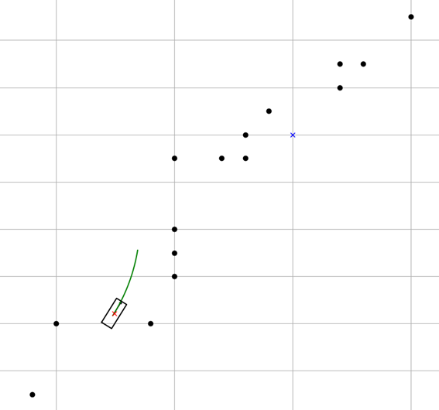
Motion Planning
Motion Planning finds a continuous sequence of valid configurations that safely and efficiently guide a robot from start to goal.
Global Planning
Navigation
Avoiding Static obstacle
Local Planning
Handle emergency
Evading moving objects
Google Map
Global Planning
Driver
Local Planning
Introduction
Methods
Results
Discussion

Slide 5
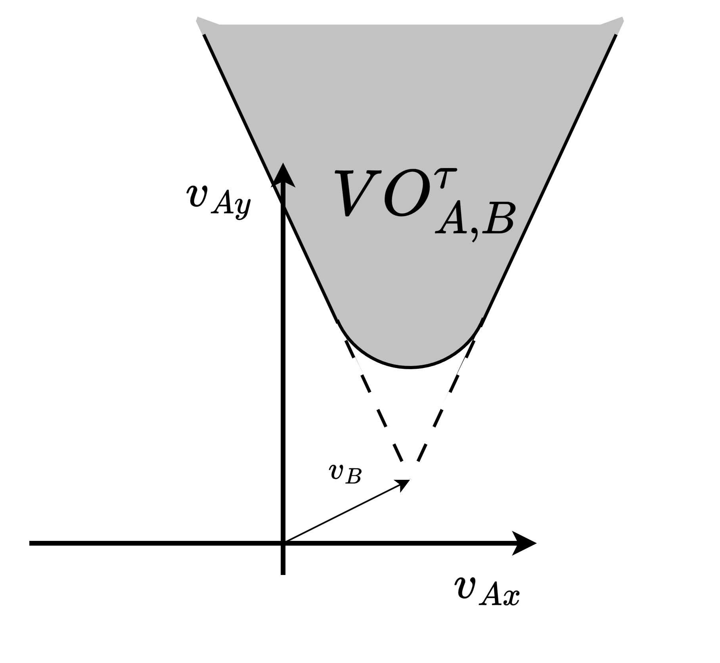
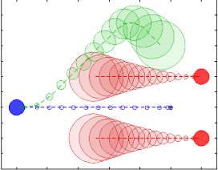
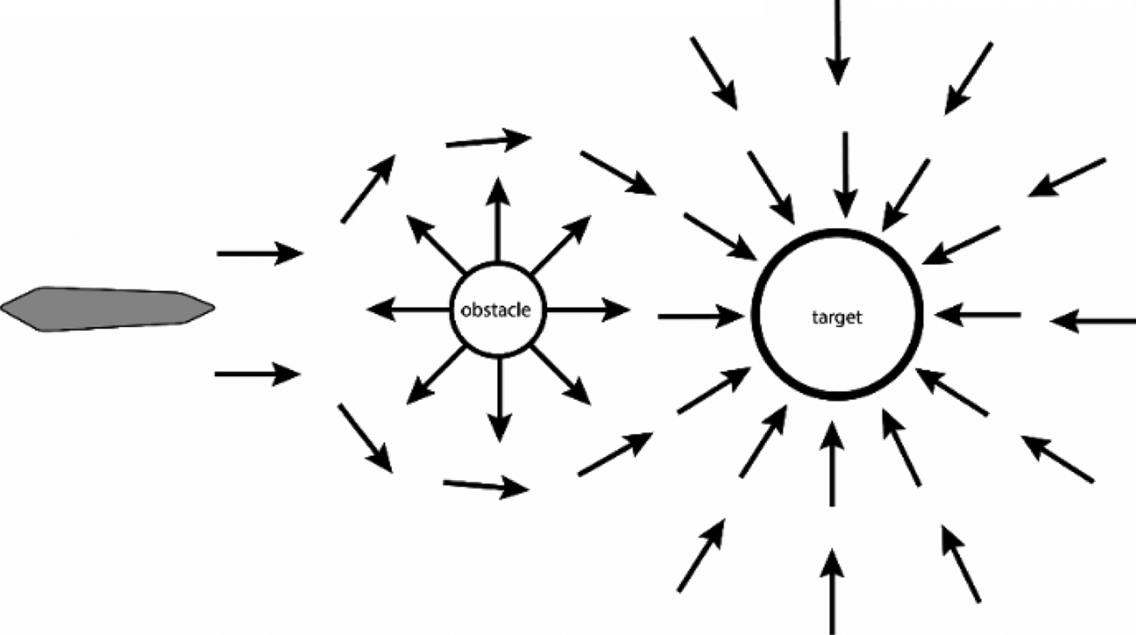
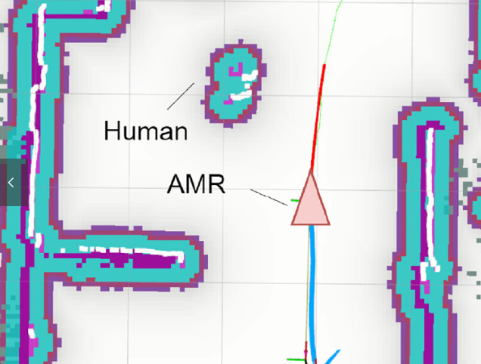
Local Planning
[1] Polvara, Riccardo, et al. "Obstacle avoidance approaches for autonomous navigation of unmanned surface vehicles." The Journal of Navigation 71.1 (2018): 241-256.
[3] Du Toit, N. E. and J. W. Burdick (2010). Robotic motion planning in dynamic, cluttered, uncertain environments. 2010 IEEE International Conference on Robotics and Automation, IEEE.
[2] Wu, C.-H. and K.-Y. Chan (2024). "Developing a dynamic obstacle avoidance system for autonomous mobile robots using Bayesian optimization and object tracking: Implementation and testing." Proceedings of the Institution of Mechanical Engineers, Part C: Journal of Mechanical Engineering Science 238(9): 4007-4022.
Artificial Potential Fields (APF) | Dynamic Window Approach (DWA) | Velocity Obstacles (VO) | Model Predictive Control (MPC)
Simple for real-time avoidance | Effective, Dynamic feasible | Deal with multi-agents systems | Handles robot dynamics
Local minima issue | Struggle with moving obstacles | Poor at handling unknow intensions | Computationally expensive
[1]
[3]
[2]
former lab members’ research
My research want to use
Introduction
Methods
Results
Discussion

Slide 6
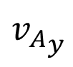
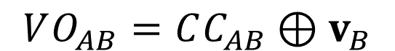
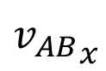
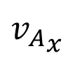
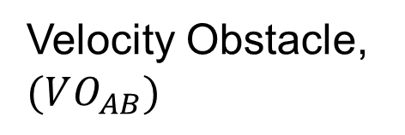
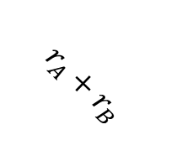
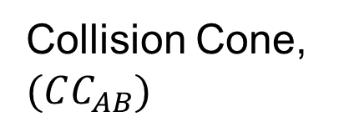
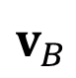
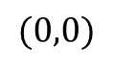
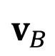
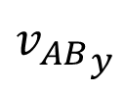
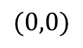
Velocity Obstacle (VO)
$$VO_{AB}=CC_{AB}⊕v_{B}$$
C-space
Velocity space
$${v_{AB}}_{y}$$
$${v_{A}}_{y}$$
Collision Cone, $(CC_{AB})$
Velocity Obstacle, $(VO_{AB})$
$$v_{B}$$
$$r_{A}+r_{B}$$
object B
$${v_{AB}}_{x}$$
$${v_{A}}_{x}$$
$$(0,0)$$
$$(0,0)$$
$$v_{B}$$
agent A
Introduction
Methods
Results
Discussion

Slide 7
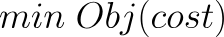
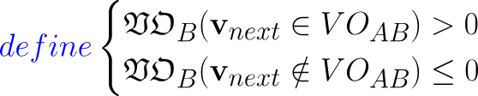
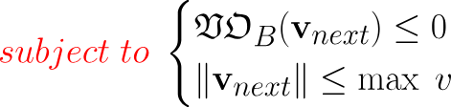
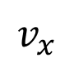

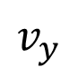
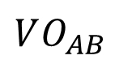
Conventional VO method
Design variables: $v_{next}$
Velocity space
$$v_{y}$$
$$VO_{AB}$$
Dynamic feasible region
Ideal velocity
$$v_{x}$$
Optimal robot’s next step
Introduction
Methods
Results
Discussion

Slide 8
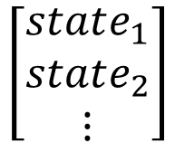
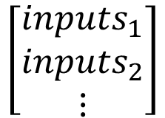

Concept of MPC
1
$$Obj (inputs_{1}, inputs_{2},⋯)$$
Reducing energy use
Getting closer to target state
Optimization problem → add constraints!!
$$\left[\begin{matrix}inputs_{1} \\ inputs_{2} \\ ⋮\end{matrix}\right]$$
System Model
$$\left[\begin{matrix}state_{1} \\ state_{2} \\ ⋮\end{matrix}\right]$$
2
Real System
Find solution → Apply only the 1st control action to
3
Update
System Model
Introduction
Methods
Results
Discussion

Slide 9
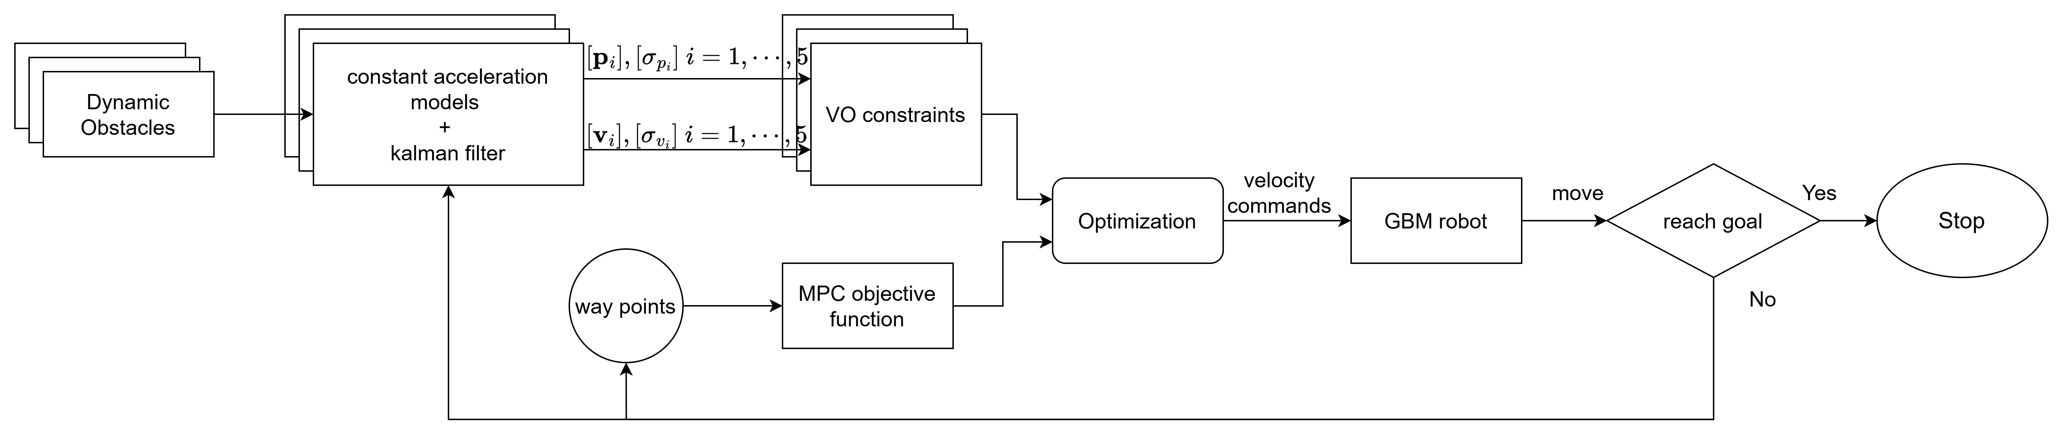
Structure of proposed method
Prediction step
Optimization step
Introduction
Methods
Results
Discussion

Slide 10
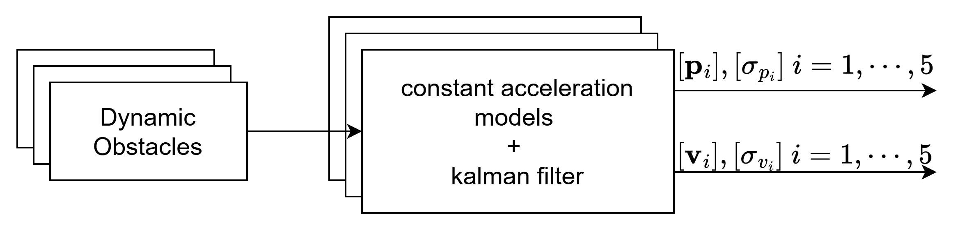

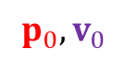
Prediction
Prediction step
Prediction
$$p_{i},v_{i}, i=1,2,3…$$
$$p_{0},v_{0}$$
Observation
Constant Acceleration Model
Dynamic Obstacle
Prediction by Kalman Filter
Introduction
Methods
Results
Discussion

Slide 11
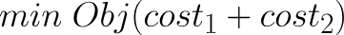
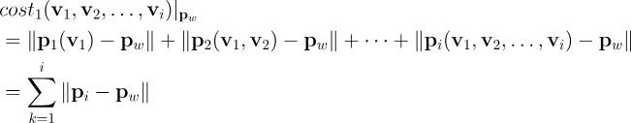
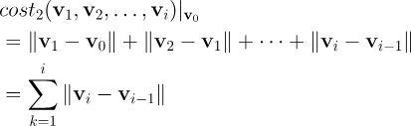
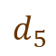

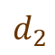

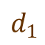

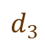
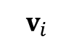
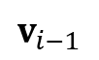
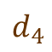
Optimization
Design variables: $v_{1},v_{2},v_{3},…,v_{i}$
Way point distances
Way point${ p}_{w}$
Way point distances
Change amount of velocity
$$d_{5}$$
$$d_{4}$$
$${||∆v}_{i}||$$
$$d_{3}$$
$$d_{2}$$
$$v_{i}$$
$$v_{i−1}$$
$$d_{1}$$
Change amount of velocities
Robot
Velocity space
Introduction
Methods
Results
Discussion

Slide 12
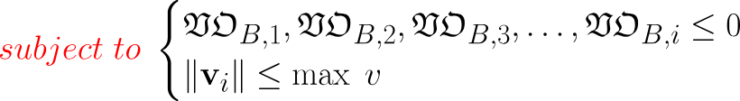
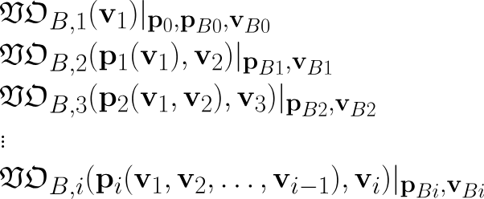

Constraints
Design variables: $v_{1},v_{2},v_{3},…,v_{i}$
Constraints:
Constraints:
$$v_{1}, v_{2}, v_{3}, v_{4}, v_{5}$$
Design variables
Constraints:
Constraints:
Constraints:
Introduction
Methods
Results
Discussion

Slide 13
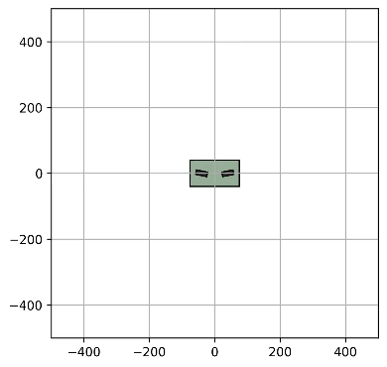
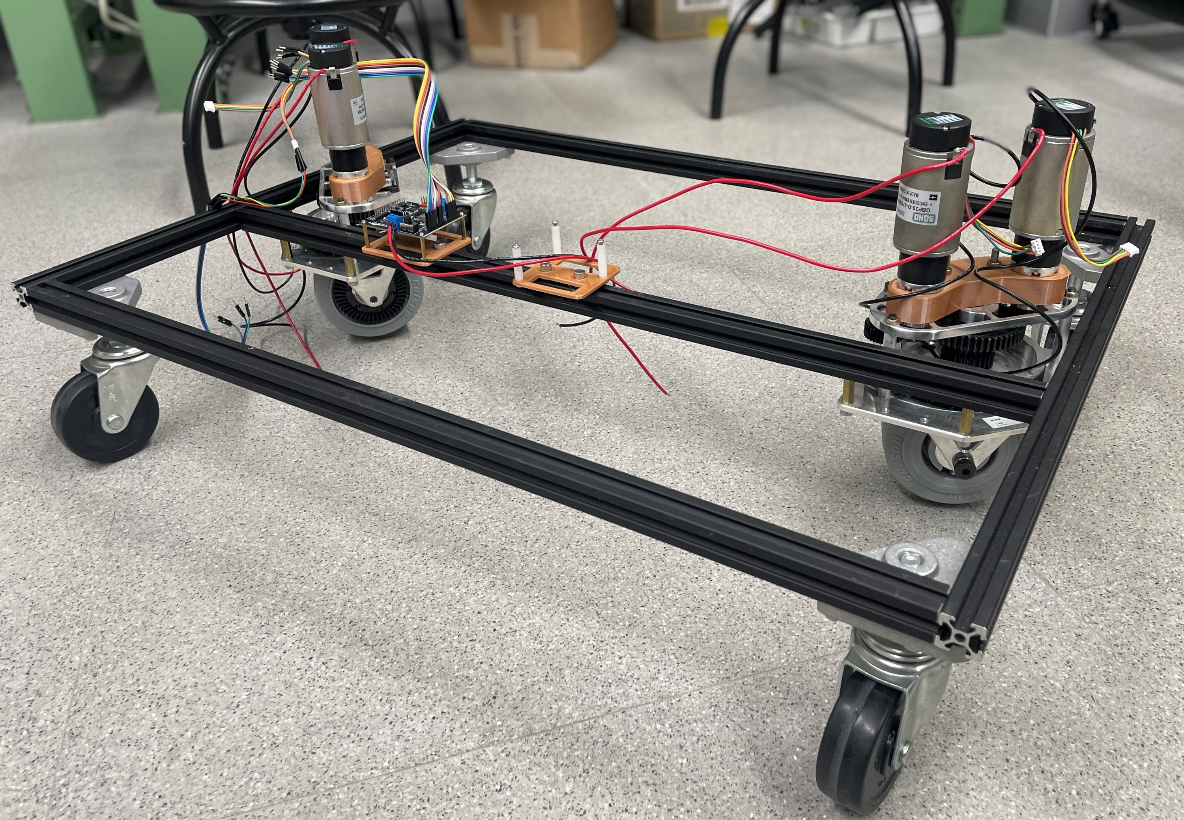
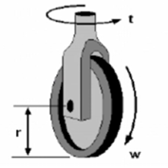
Tested AMR
Generalized Bicycle Model
2 wheels that can rotate and spin independently
Holonomic robot (heading and orientation are decoupled)
rotate
rear wheel
Front wheel
spin
Introduction
Methods
Results
Discussion

Slide 14
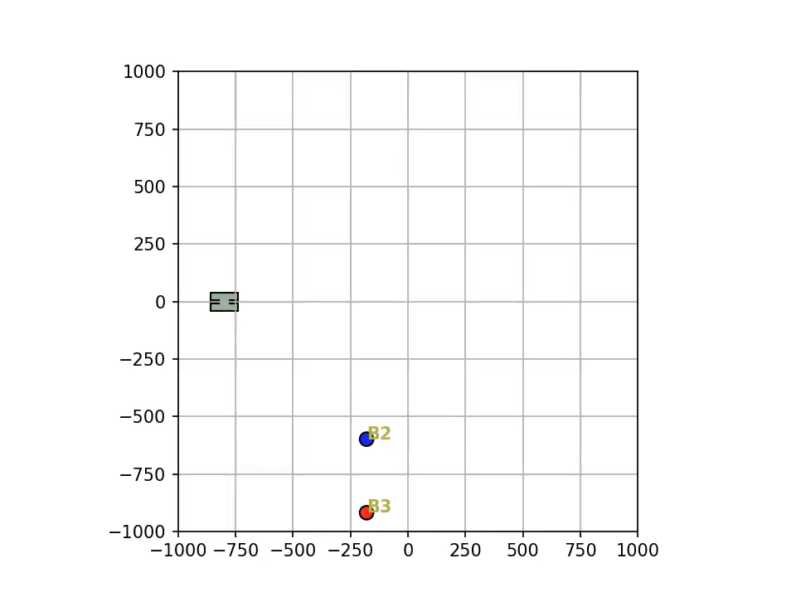

Simulation Result
method | Conventional VO | Expanded VO
collision | Collide | safe
Reach time | 19.98 second | 16.84 second
Introduction
Methods
Results
Discussion

Slide 15
Discussion
Contribution: this research proposed a obstacles avoidance method that handles unknow intentions effectively.
Future works:
Adjust the prediction horizon or modify the step length depends on the accuracy of prediction.
Add more dynamic obstacles into the simulation, and make their movements highly unregular.
Introduction
Methods
Results
Discussion

Slide 16
National Taiwan University
System Optimization Laboratory
Predictive Velocity Obstacle Method for Mobile Robot Motion Planning Among Dynamic Obstacles with Unknown Intentions

Slide 17
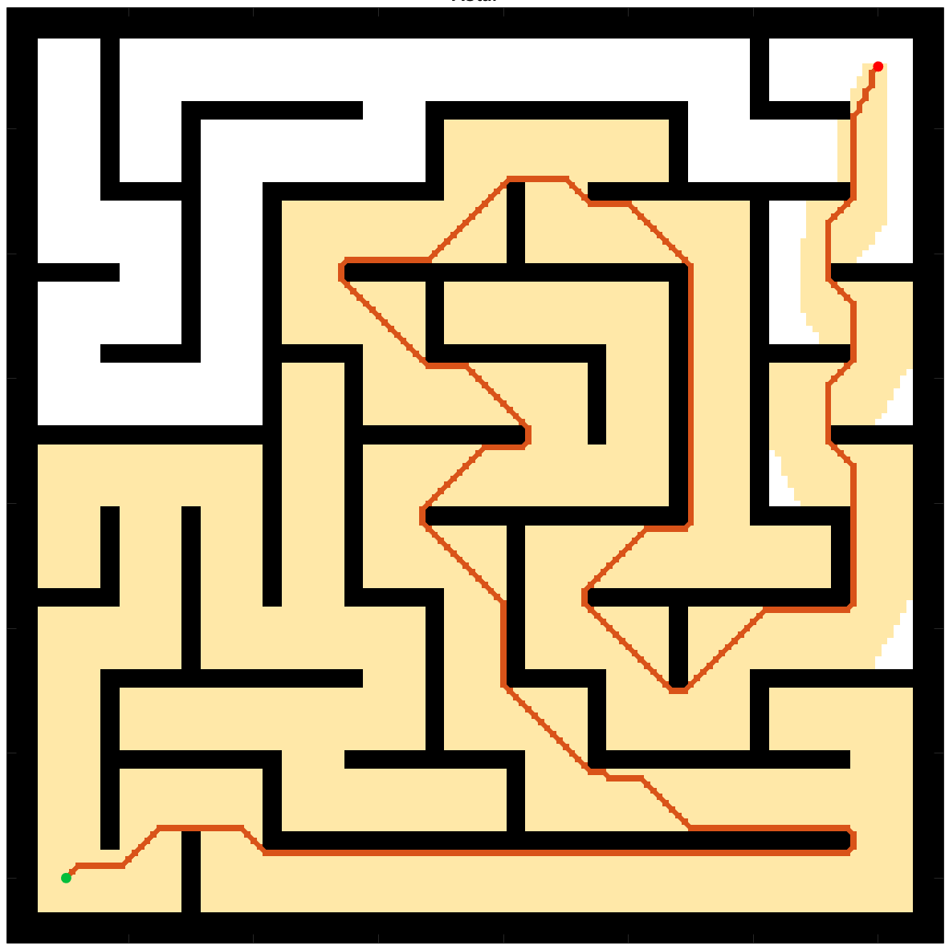
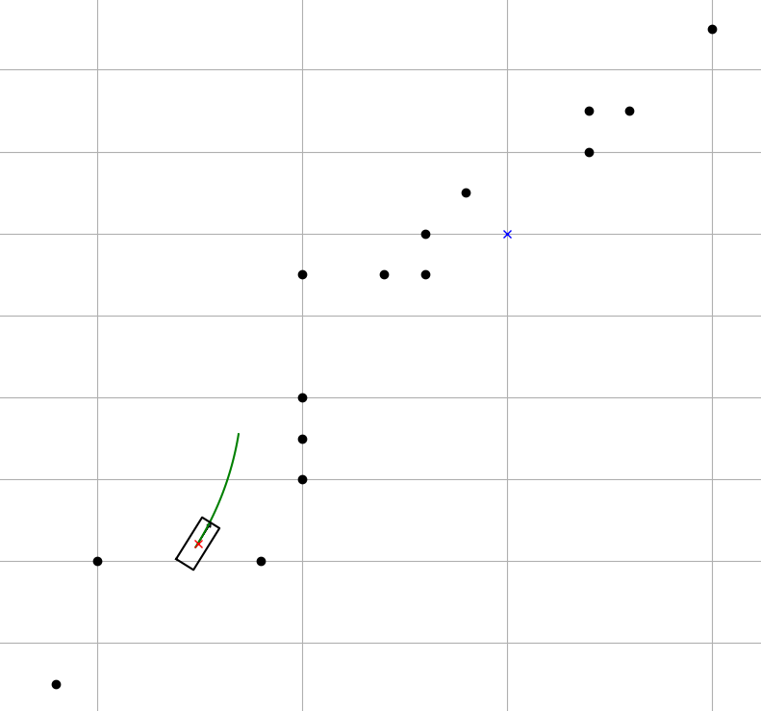
Introduction of Path Planning
B
A
Global Planning
Local Planning
Introduction
Methods
Results
Discussion

Slide 18







Optimization step
Minimize
Way point distances
Objective Function (design variable: $v_{i}, i=1,2,3…$)
= ∑ way point distances + ∑ change amount of velocity
Subjected to:
Velocity Obstacles
Way point
Change amount of velocity
$$d_{5}$$
$$d_{4}$$
Optimization step
$${||∆v}_{i}||$$
$$d_{3}$$
$$d_{2}$$
$$v_{i}$$
$$d_{1}$$
$$v_{i−1}$$
Robot
Velocity space
Introduction
Methods
Results
Discussion

Slide 19








Optimization step -- VO
$$v_{y}$$
$$v_{y}$$
Collide in $τ$ seconds → danger
$$VO_{AB}$$
$$VO_{AB}^{τ}$$
Collide after $τ$ seconds → relatively safe
Ideal velocity
Cut off the relatively safe region
Dynamic feasible region
$$v_{x}$$
$$v_{x}$$
Introduction
Methods
Results
Discussion

